Slide 1
NFL Passing Touchdown Predictions
Jared Case
Erik
Feb 13, 2019

Slide 2
Presentation Overview
Process
Data Overview
Model Construction/Performance
User Interface Demo

Slide 3
Process
Predict NFL Passing Touchdowns
2. Build Model
a. Keras Sequential Model
3. User Interface
1. Data Source
a. Footballdb.com
b. Clean Data
b. Verify model performance
c. Save model
Flask/HTML

Slide 4

QB Attributes – Input (x_train)
QB Attributes – Output
(y_train)
Att = Pass Attempts
Cmp = Pass Completions
Pct = Pass Completion Percentage
Yds = Passing Yards
YPA = Yards Per Pass Attempt
TD% = Touchdown Pass Percentage
Int = Intercepted Passes
Int% = Pass Interception Percentage
Lg = Longest Pass Completion
Sack = Passing Sacks
Loss = Sack Yards Lost
Rate = Passer Rating
TD = Touchdown Passes
footballdb.com

Slide 5
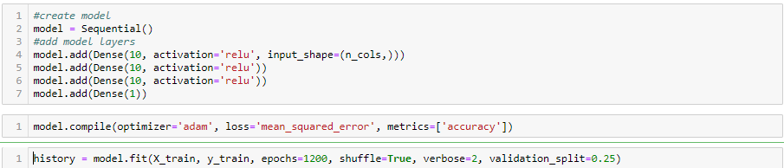


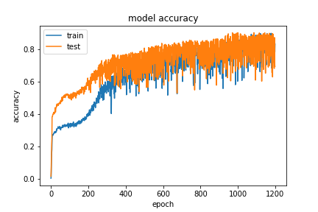
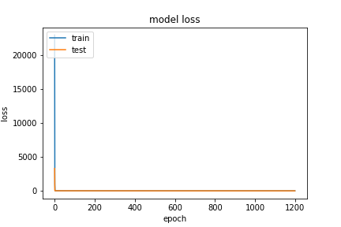
Keras Sequential Model

Slide 6
User Interface Demo

